Slide 1
Materials

Slide 2
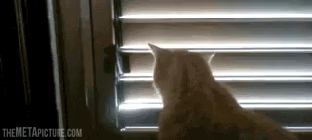
By the end of this Smart Lesson, you should be able to:
Describe the properties of materials that are transparent, translucent and opaque.
Describe the way light behaves when it interacts with transparent, translucent and opaque objects.
Identify common examples of transparent, translucent and opaque objects.

Slide 3
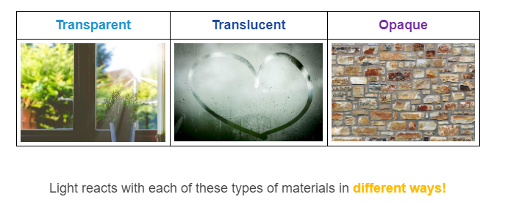
There are three classes of material:

Slide 4
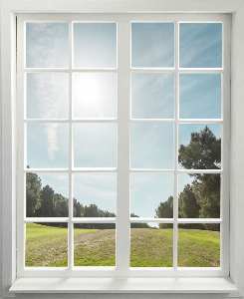
Light passes through some materials without being distorted.
These are transparent materials.
We can look through a transparent object and clearly see objects on the other side with great detail.

Slide 5
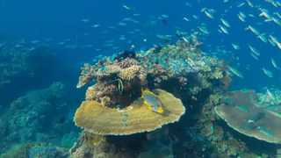
We can see a clear image through a transparent material because all of the light can pass through the object.
Some examples of transparent objects are glass windows, clean water and air.
Light that is passing through an object is transmitted.

Slide 6
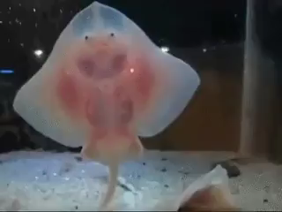
Only some light can pass through a translucent material. The rest of the light is reflected.
Translucent materials give a fuzzy image of objects on the other side, and they are hard to see through.

Slide 7
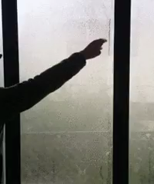
When you look through a translucent material you see a blurred image.
Light from an object scatters inside the translucent material, so the light that you see is mixed up and fuzzy. Some examples of translucent materials are fogged glass, jelly and some plastics.

Slide 8
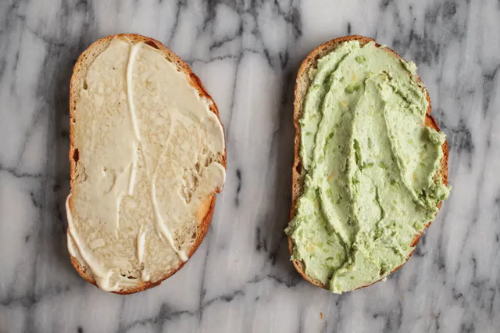
Opaque materials do not allow any light to pass through them.
Instead, the light is either reflected from the surface or absorbed by the object.

Slide 9
We cannot see an image through opaque materials.
Most materials are opaque. Some examples are wood, bricks and some plastics.

